Slide 1
EN.580.428 Genomic Data Visualization Lesson 2 Quality Control and Summary Statistics
Prof. Jean Fan

Slide 2
Lesson learning objectives
Review our understanding of spatial transcriptomics data based on the datasets we now have access to
Perform quality control analysis using data visualization
Compute various summary statistics

Slide 3
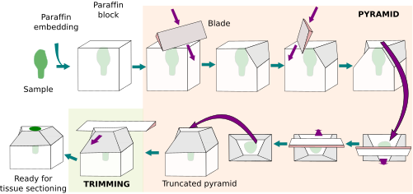
You’re working with 15um thin sections of tissue

Slide 4
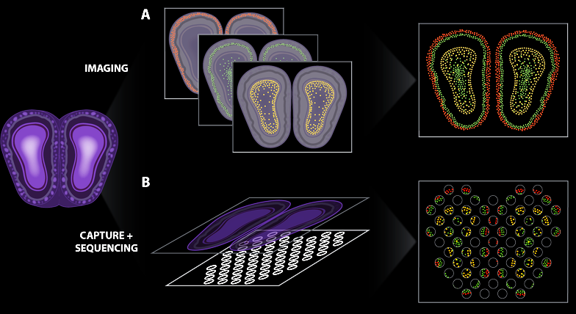


Spatially resolved transcriptomic technologies enable us to profile what genes are expressed by cells in tissues
(Atta and Fan, Nature Communications, Sept 2021)
Notes:
different technologies
vary in terms of throughput, sensitivity, resolution
statistical analysis methods will be different
7

Slide 5
Spatial transcriptomics by multiplexed smFISH

Slide 6
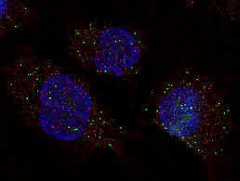
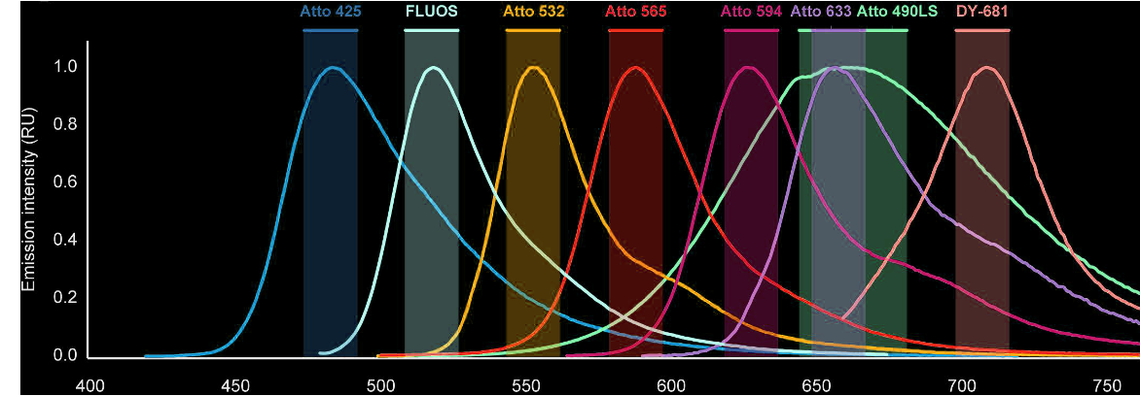
smFISH enables imaging of single mRNA molecules
Fluorophore
Oligonucleotide
gene1
gene2
gene3
(Femino et al., Science, 1998)
(Raj et al., Nature Methods, 2008)
(Lukumbuzya et al., Front. Microbiol, 2019)

Slide 7
Practice
Fluorophore
Oligonucleotide
gene1
Cell B
gene2
gene3
Cell A
Convert to count matrix →

Slide 8
(Slide courtesy of Chenglong Xia)

Slide 9
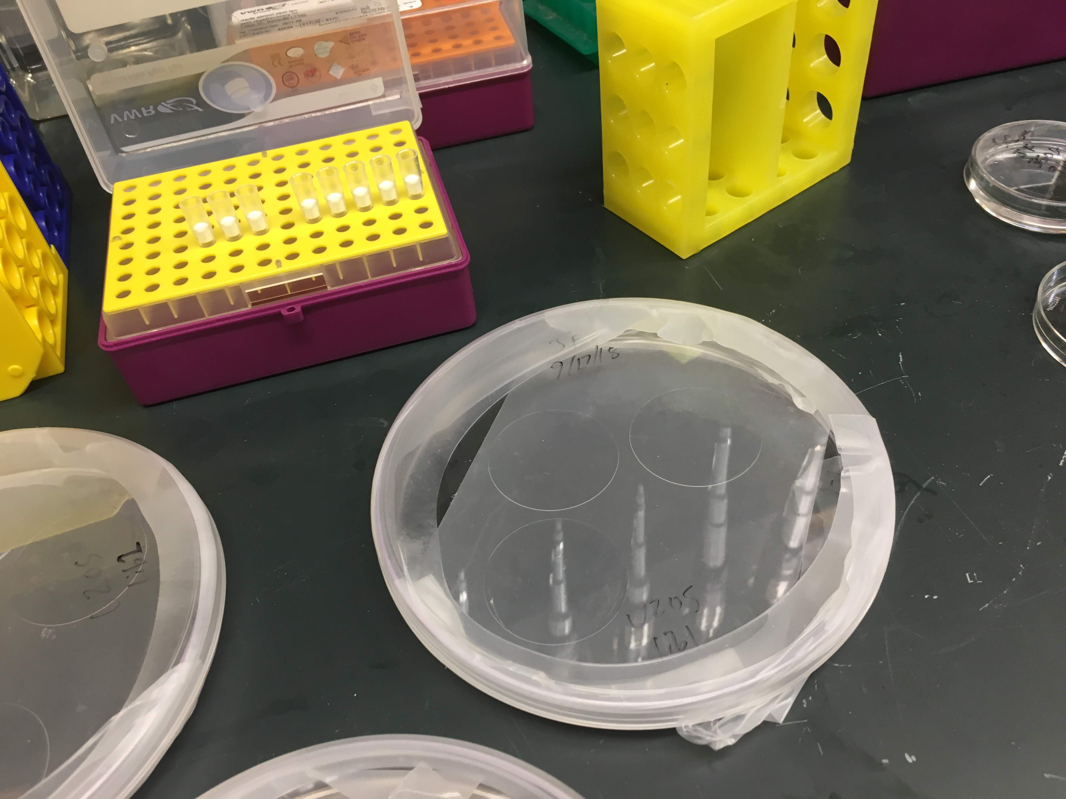
fix cells, hybridize encoding probe @46C over night, wash away unbound probes

Slide 10
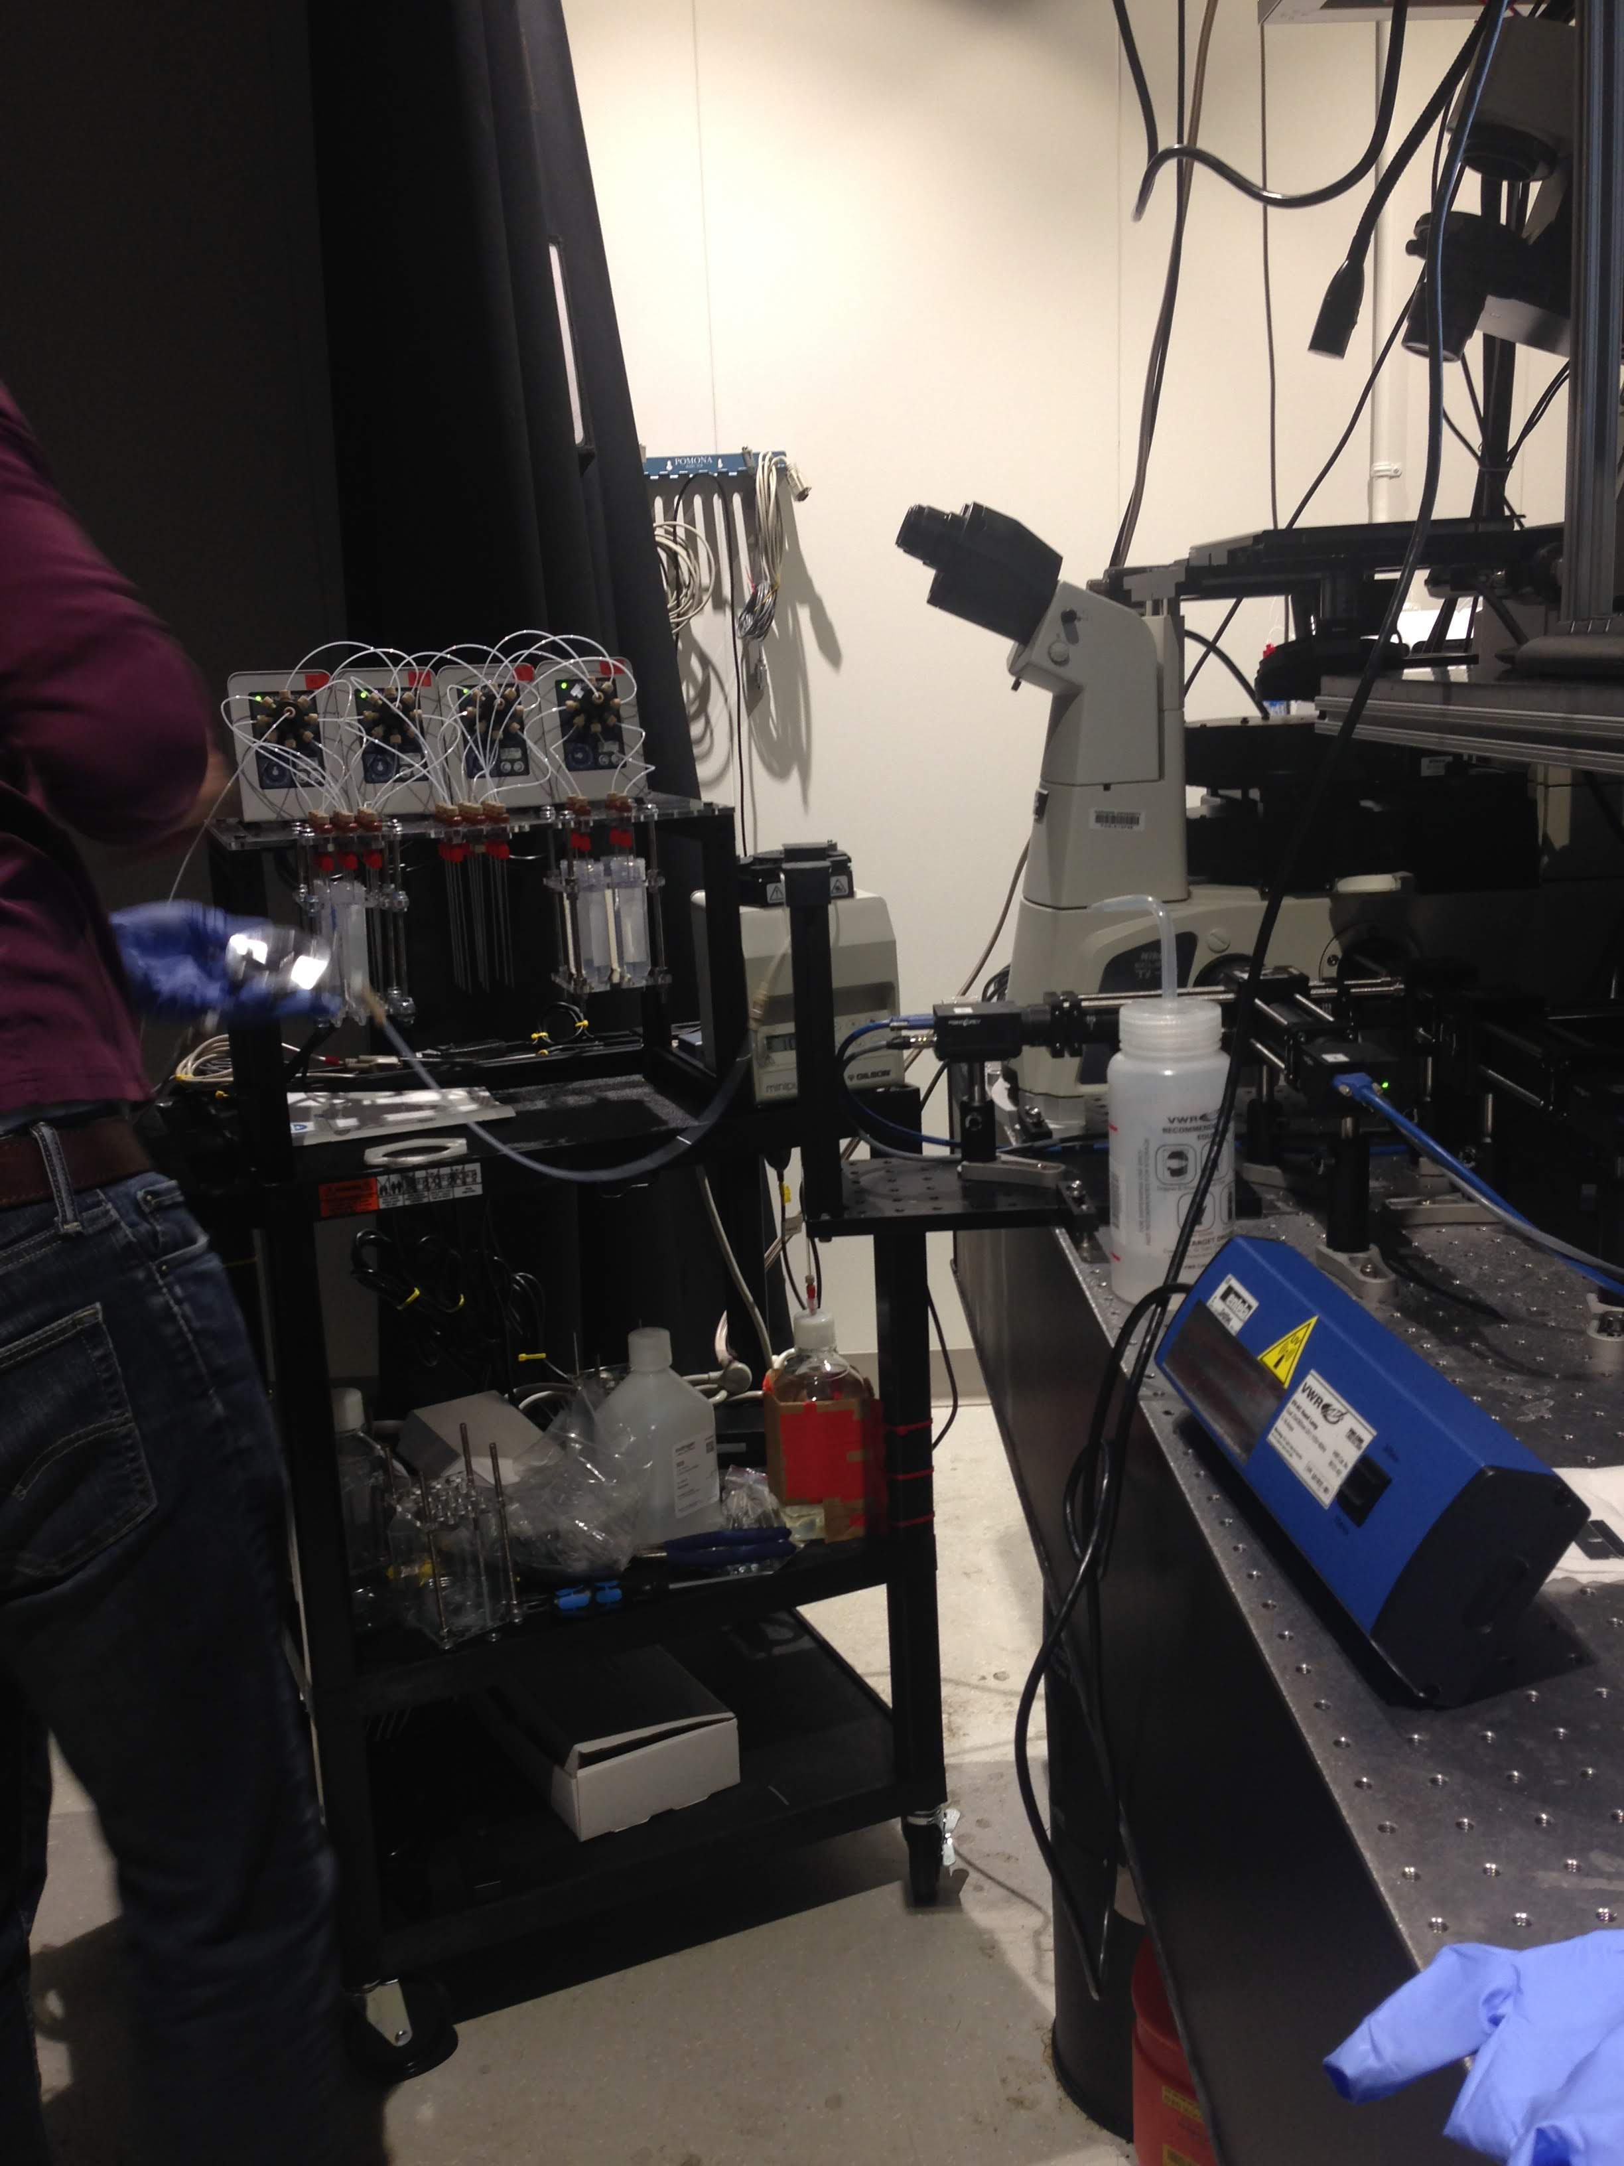
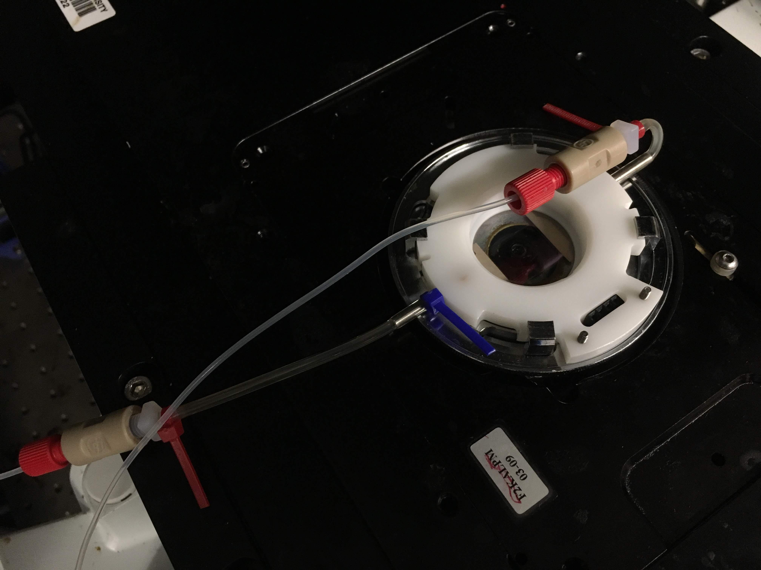
flow on readout probes using microfluidics, wait a few minutes, wash away unbound probes

Slide 11
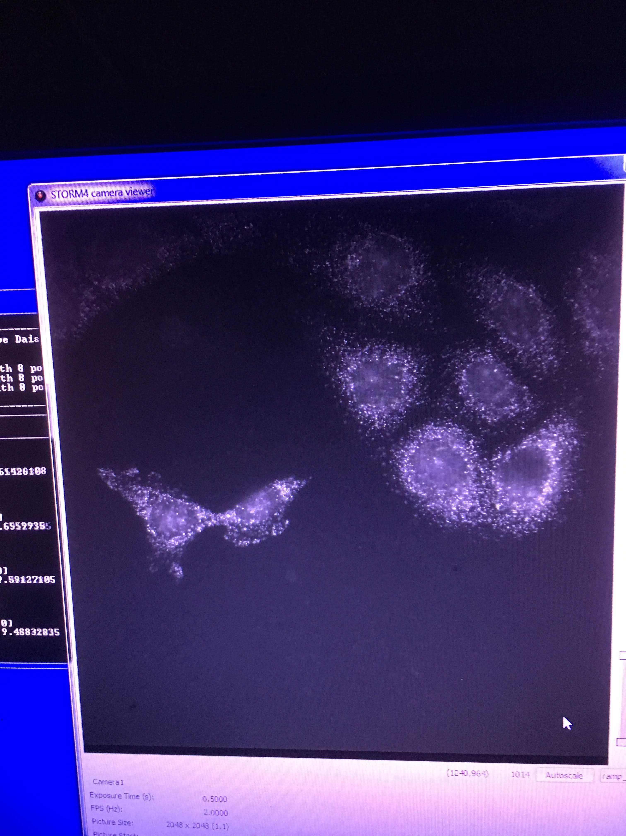
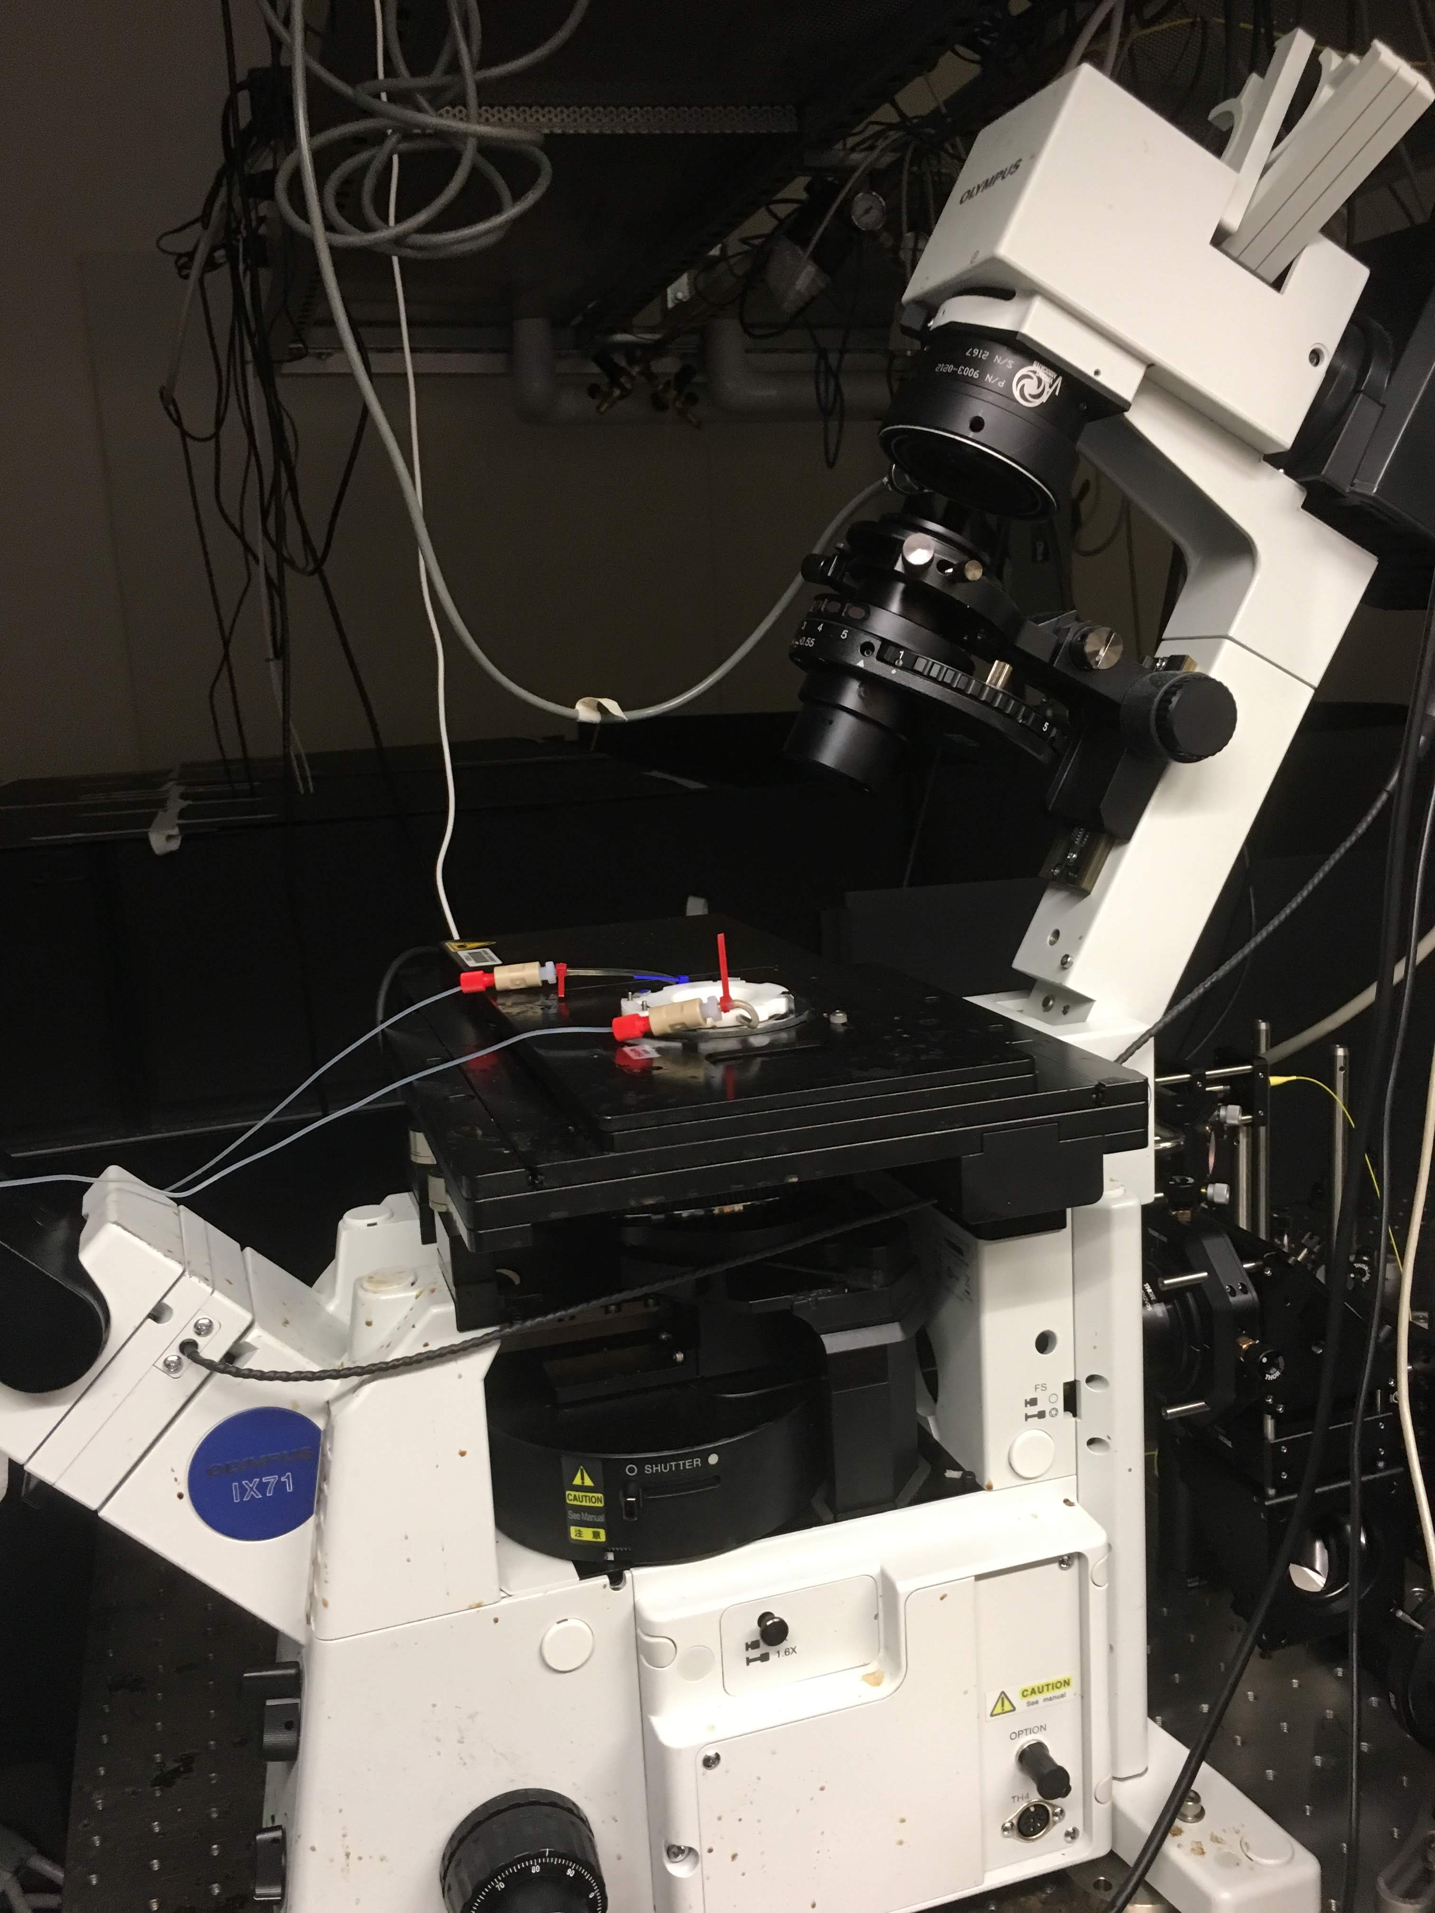
take pictures across many fields of views

Slide 12
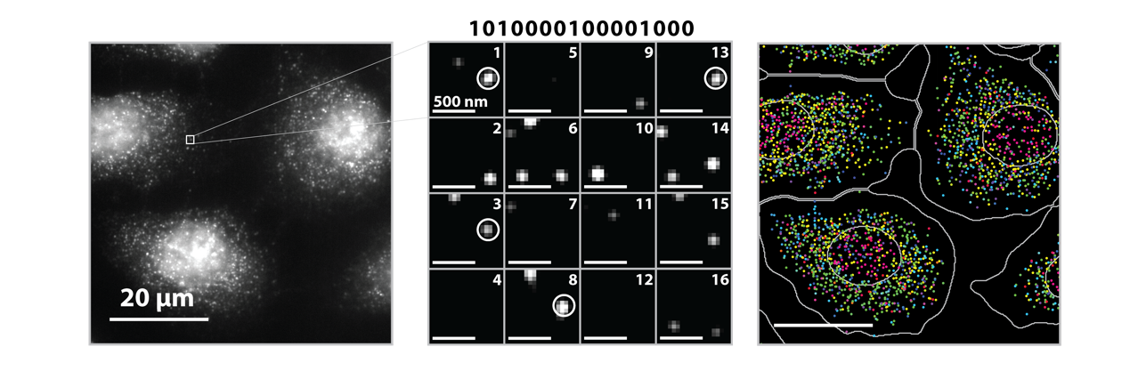
Source: Vizgen, Moffitt lab

Slide 13
Spatial transcriptomics by spatially resolved capture + next-gen sequencing

Slide 14
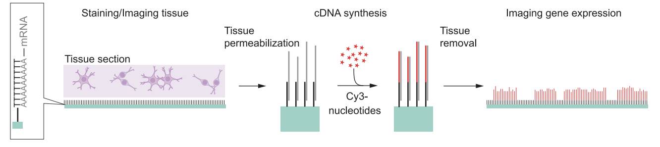
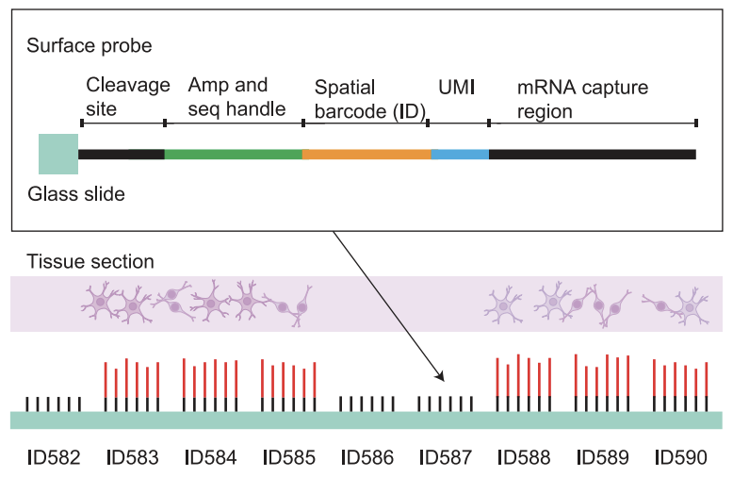
(Stahl et al 2016)

Slide 15
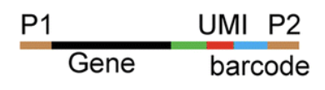
What our data looks like
spatial
barcode
gene
UMI
ATCGGATCGTATAAATGCGTAGCTAGTC----AATG----AGTT
ATCGGATCGTATAAATGCGTAGCTAGTC----TTTG----AGTT
ATCGGATCGTATAAATGCGTAGCTAGTC----TTTG----AGTT
TTGAGTATATGATGAAGATGAAAGGAT----AGGT----AGTT
TTGAGTATATGATGAAGATGAAAGGAT----ATTG----GTAA
TTGAGTATATGATGAAGATGAAAGGAT----GATA----GTAA
…
…

Slide 16
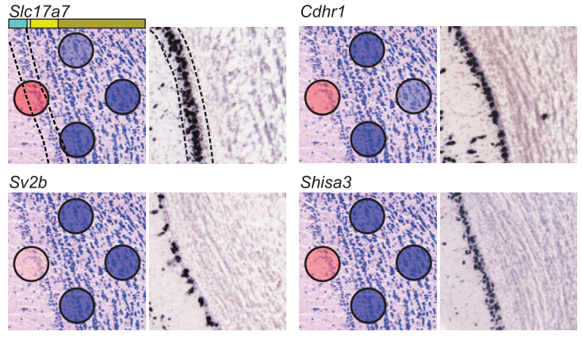
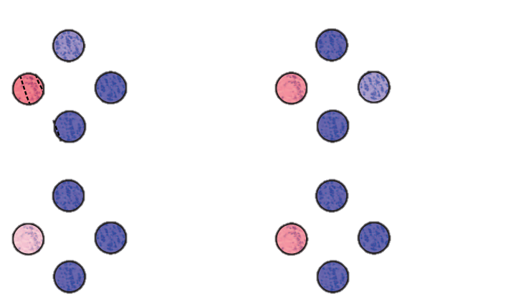
Observed count matrix →
(Stahl et al 2016)

Slide 17
(Stahl et al 2016)

Slide 18
What are the pros and cons of each spatial transcriptomic approach?
Practice

Slide 19
Common quality control metrics
How many total genes are detected per cell/spot?
How many unique genes are detected per cell/spot?
What is the total expression of each gene across all cells/spots?
What is the average expression of each gene across all cells/spots?
How many cells/spots is a particular gene detected in?

Slide 20
Consider an imaging smFISH-based spatial transcriptomics dataset
Practice
Prof. Fan calculates how many total genes are detected per cell
She notices a cell has 0 genes detected
She concludes the cell is dead
Do you agree?

Slide 21
Consider an imaging smFISH-based spatial transcriptomics dataset
Practice
Prof. Fan calculates the total expression of each gene across all cells
She notices a gene for which this total expression is 0
She concludes that the probes she designed for this gene must have all failed
Do you agree?

Slide 22
Consider a spot sequencing-based spatial transcriptomics dataset
Practice
Prof. Fan calculates how many total genes are detected per spot
She notices a spot has 0 genes detected
She concludes all the cell in this spot are dead
Do you agree?

Slide 23
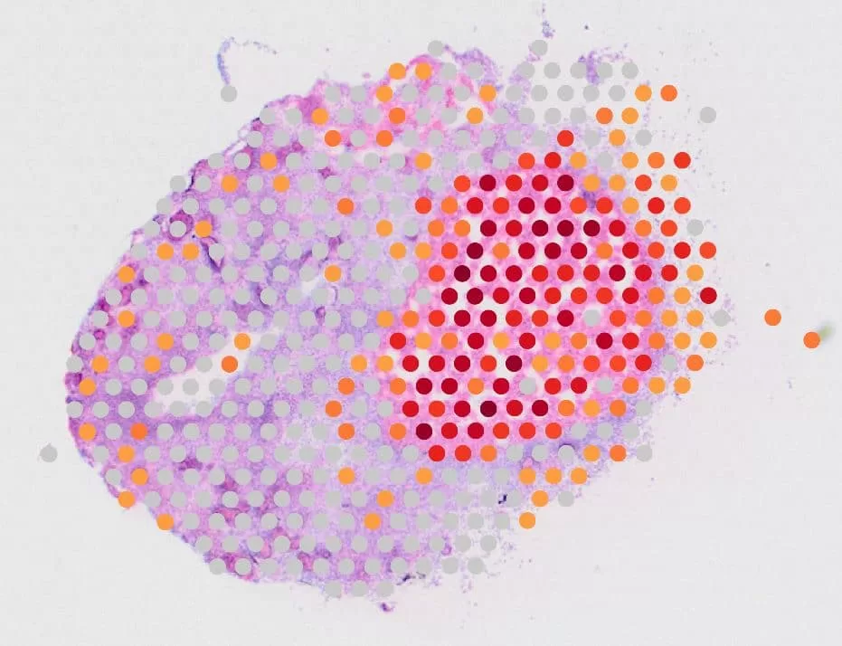

Slide 24
Hands-on component
Writing loops
Calculating summary statistics
How many total genes are detected per cell/spot?
How many unique genes are detected per cell/spot?
What is the total expression of each gene across all cells/spots?
What is the average expression of each gene across all cells/spots?
How many cells/spots is a particular gene detected in?
Histograms

Slide 25
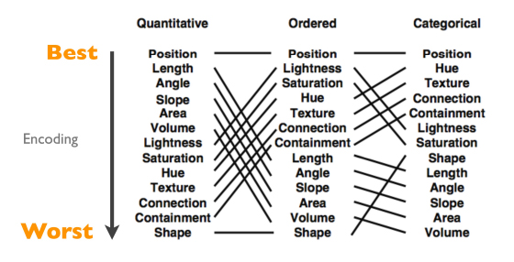
Fill out your reflection card
HW1 due tonight
Hint: justify your choices. If you used a particular visual channel, why did you do it? Could you have chosen something else?
Quiz Friday

